Slide 1
Robotics COMP207
ALGERNON
Project: Micro-Mouse
By Luke Steppens

Slide 2
03
BRIEF INTRODUCTION
04
ELECTRONIC COMPONENTS
LIST OF CONTENTS
05
PRINTED CIRCUIT BOARDS AND ASSEMBLY
08
DESIGNED COMPONENTS
11
LASER CUTTING AND 3D SCANNING
13
PROGRAMMING
14
COMPOSITE COMPONENT
15
VERSION CONTROL AND NOTION
16
RECOMMENDATIONS

Slide 3
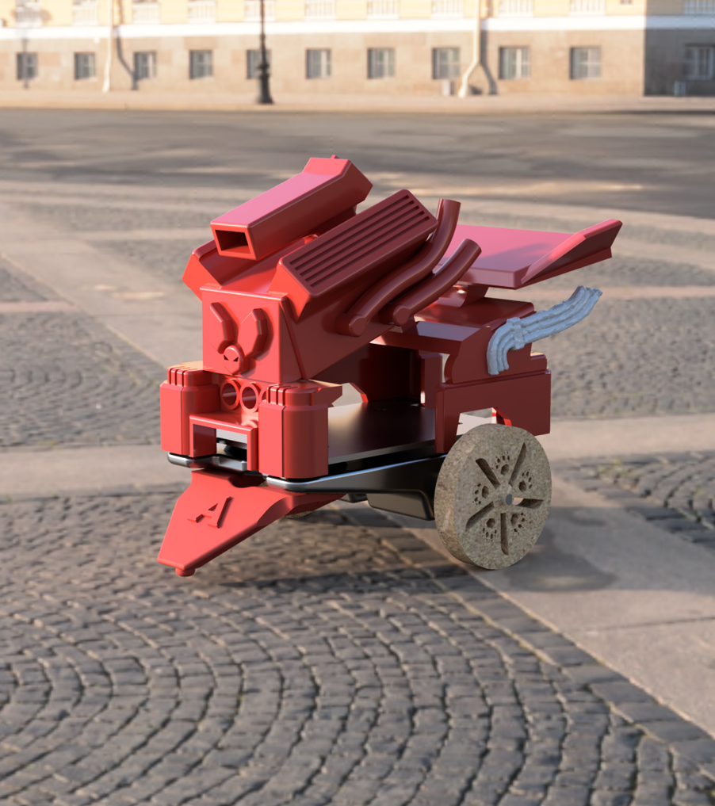
INTRODUCTION
The goal of this project is to design and manufacture an autonomous micro mouse capable of navigating a pre built maze, following the UKMARS micro mouse contest rules*
Software utilised for this project:
EasyEda: Printed Circuit Board Design
Fusion 360: 3D Modelling
Arduino IDE: Programming
Equipment used for this project
3D Printers
Laser Cutters
Soldering irons
General workshop tools
Algernon
The Micro-Mouse
*For micro mouse contest rules visit this link

Slide 4
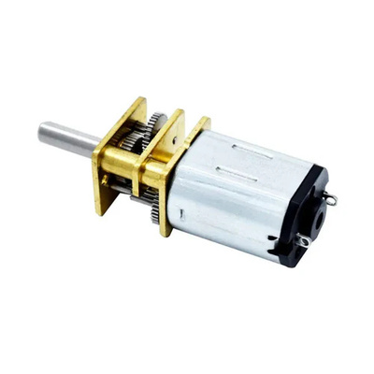
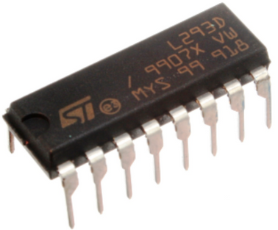
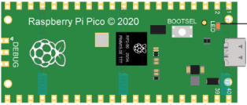
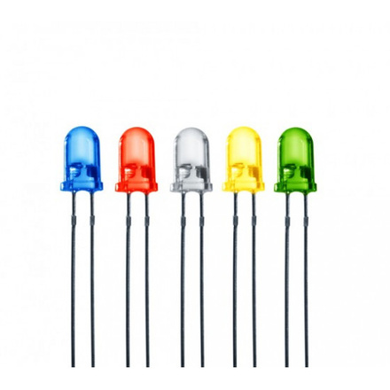
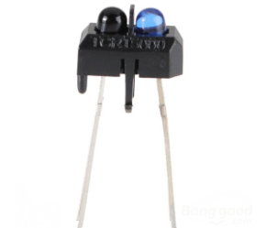
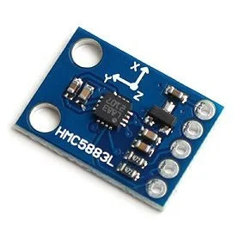
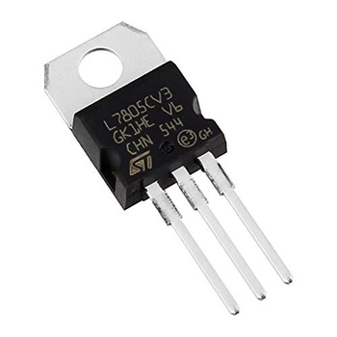
ELECTRONIC COMPONENTS
Microcontroller:
Pi Pico
DC Motors:
12V N20
Motor Driver:
L293D
Proximity Sensor:
TCRT5000
Magnetometer:
GY-271 HMC5883L
Voltage Regulator:
L7805
Light Emitting Diodes:
White, Blue ,Red
These are the premade electronic components used in this project

Slide 5
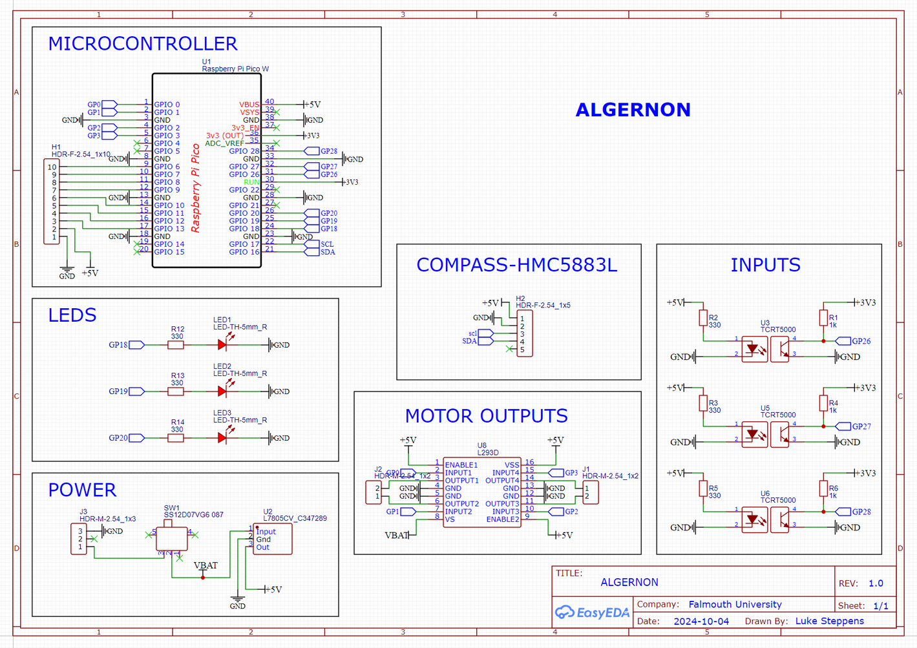
EasyEda Design
PRINTED CIRCUIT BOARDS AND ASSEMBLY
The first stop on the micro mouse journey was designing the schematic for all the components.
Connect all components to correct pins
Components in series are correct, such as LEDs and resisitors
Consult your datasheet for correct values
The distributor of the Compass had incorrect values on the website and because of this the final PCB was soldered incorrectly. Checking the datasheet would have taken moments and saved a lot of time that had to be spent debugging and testing.

Slide 6
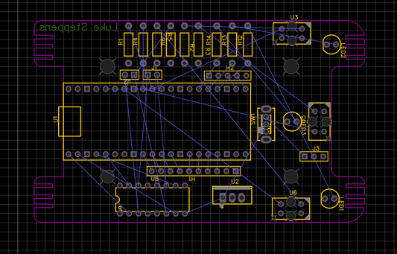
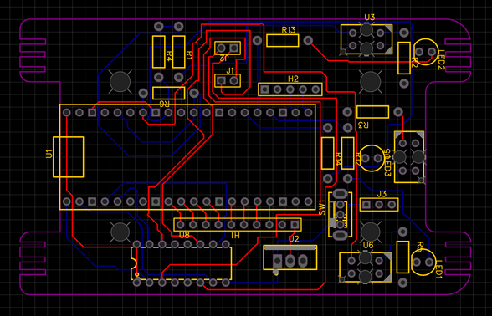
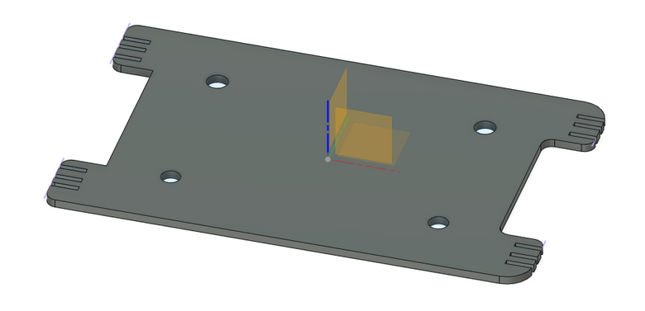
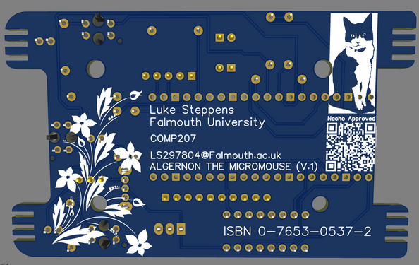
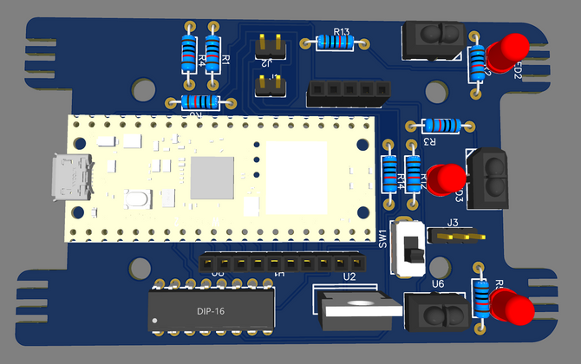
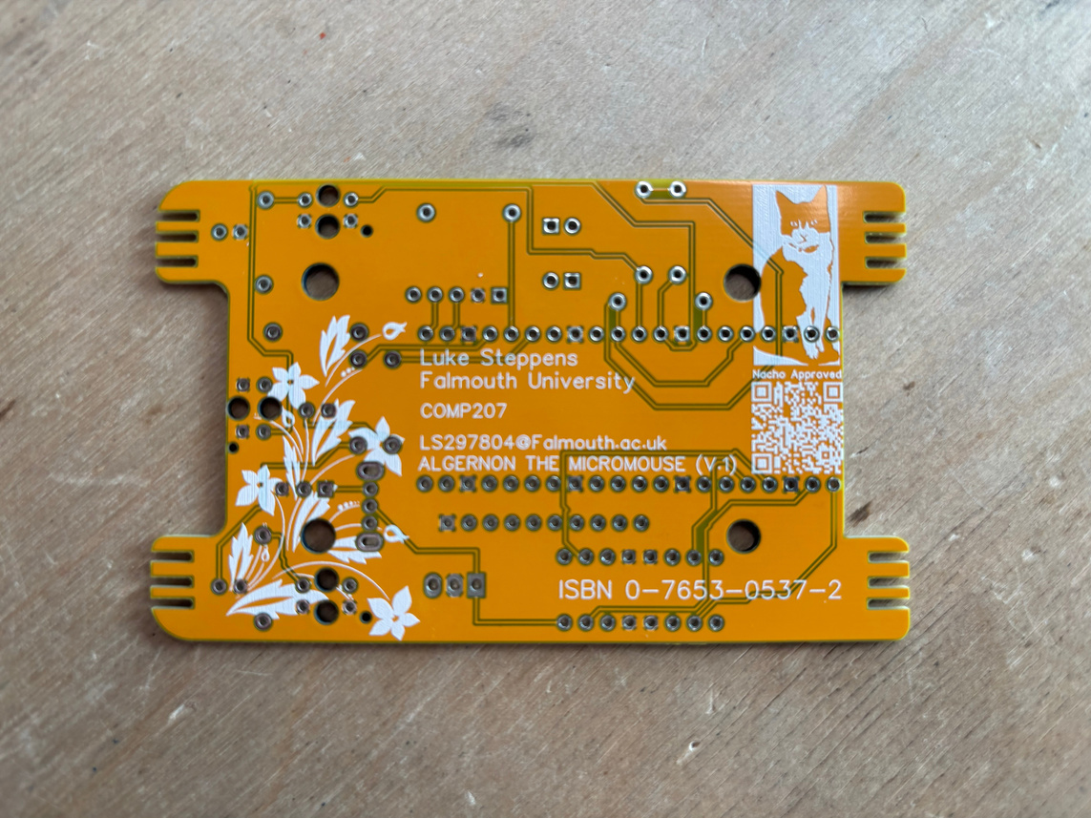
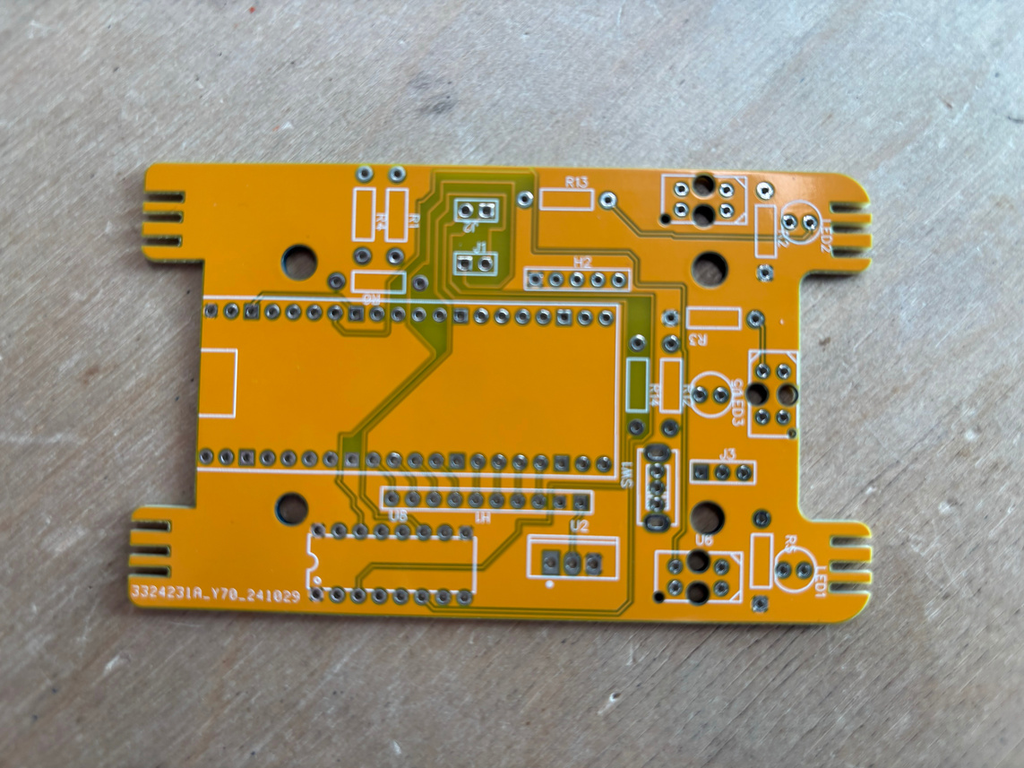
PCB EVOLUTION
Fusion 360
EasyEDA
Before Track Layout
After Track layout
3D Render Underside
3D Render Top Side
Issue encountered:
I adjusted the track width to simplify the design, but this caused significant issues. I decided to reset the PCB layout, allowing me to start fresh and reorganize the tracks effectively.
Check your schematics before soldering!
I didnt do this and soldered the Pi Pico headers on the wrong side
Final Product Under side
Final Product Top Side

Slide 7
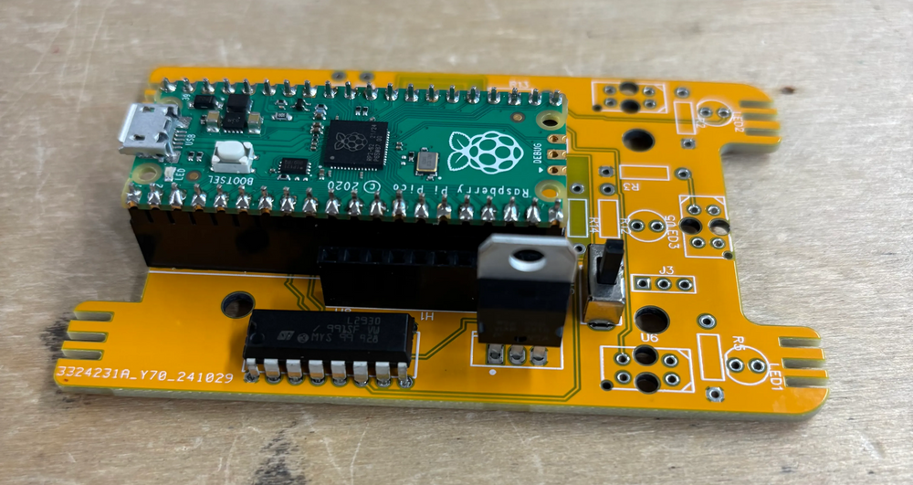
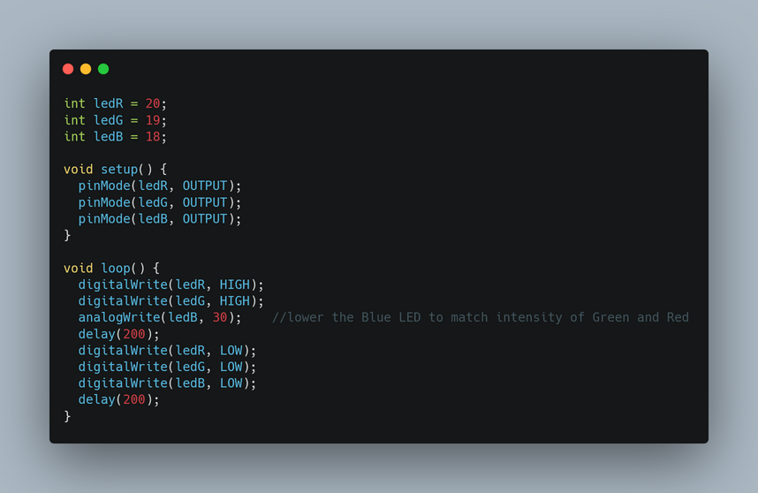
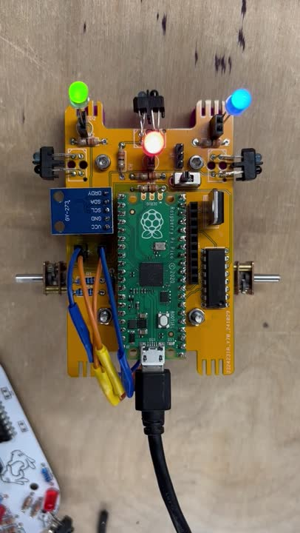
PCB ASSEMBLY
Attaching the components to the board was straightforward soldering. However, ensuring the resistors had the correct resistances and were properly positioned was crucial to prevent future issues.
Basic LED Code written in Arduino IDE

Slide 8
DESIGNED COMPONENTS
Designed and fabricated Pieces:
Basic Chassis
Motor Mounts
Battery Holder
Bumper
Tires
Final Chassis
Wheels
"The freedom to create our own parts comes with a major caveat: it also means creating more problems for ourselves—problems we then have the opportunity to solve."
— Luke Steppens, The Book of Pretentious Self-Quoting

Slide 9
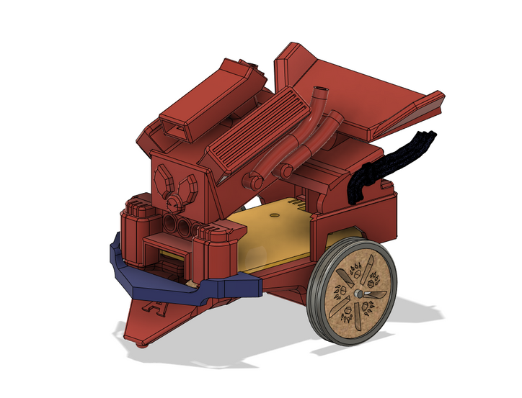
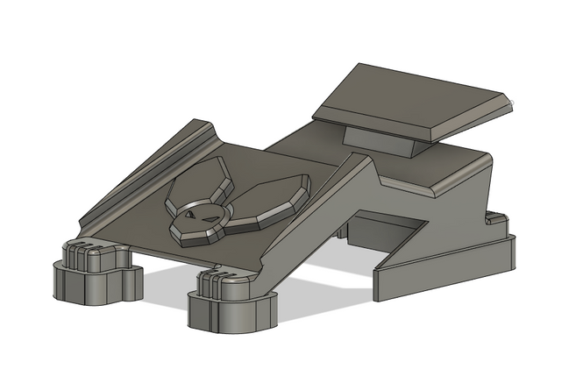
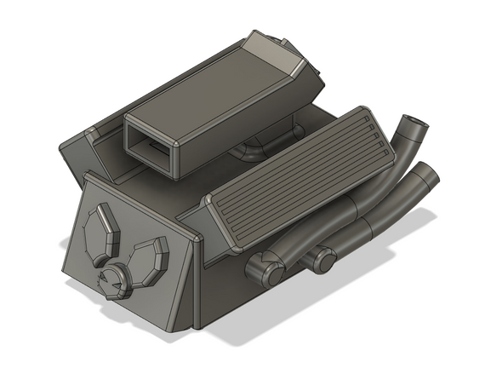
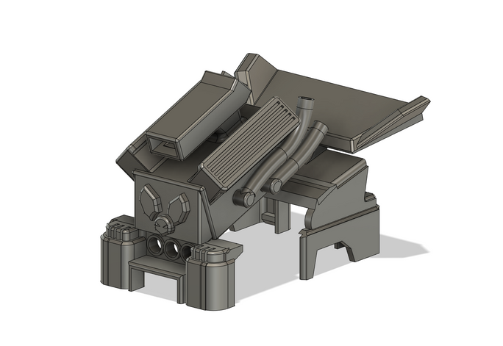
CHASSIS
EVOLUTION
From the relatively simple to overly engineered
Overall fun design but very visually noisy and needlessly overcomplicated.
Mostly simple design with the mouse logo flourish and some geometry showing signs of complexity at the front.
Obvious inspiration from V8 engines as a battery holder. A fun learning experience
Due to meeting of seperate complex geometries combining the two bodies was very difficult.

Slide 10
Extrusion
Rectangular Pattern
Circular Pattern
Pipe
Mirror
Fillet
Chamfer
Combine
Offset
Scale
Shell
Joint
Offset Plane
Appearance
Fusion 360
TECHNIQUES
These are a selection of the tools used to create the Chassis, Wheels, Tires, Battery Holder and Bumper.

Slide 11
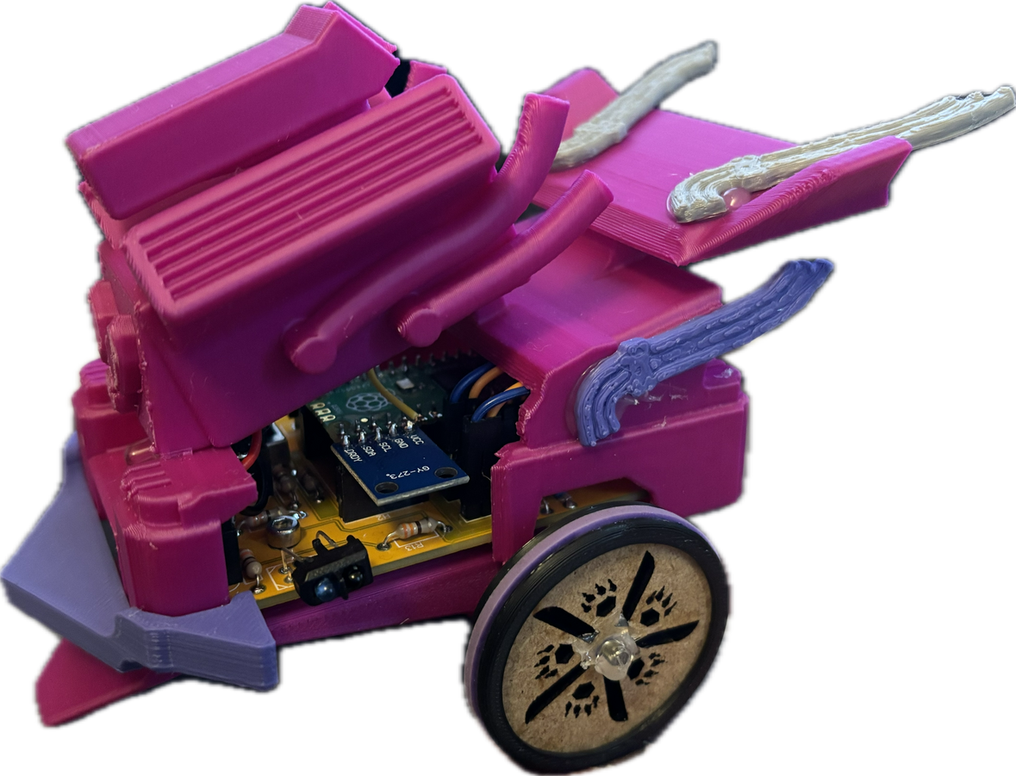
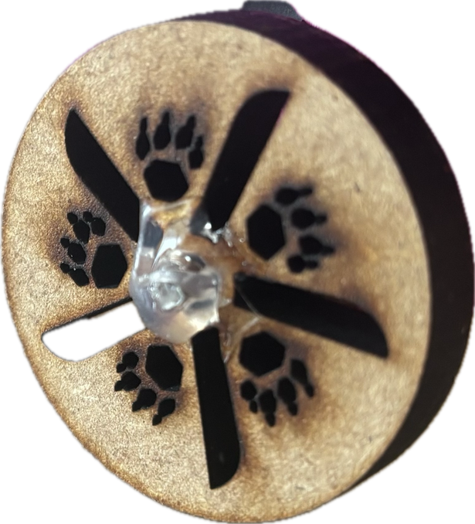
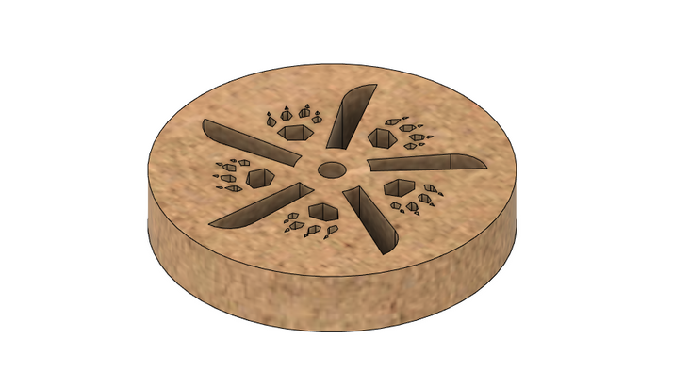
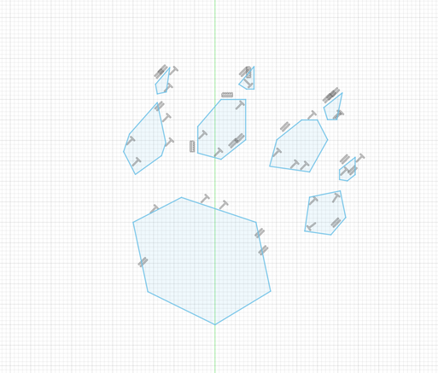
LASER CUTTING
A quick line-based design combined with the circular pattern tool allowed for a paw design to be laser cut. The paw design, along with the wheel, was laser cut in the same process. Laser cutting offers several advantages over 3D printing:
It is significantly faster, enabling quicker iterations.
It uses more sustainable resources.
It provides greater precision for finer details compared to 3D printers.

Slide 12
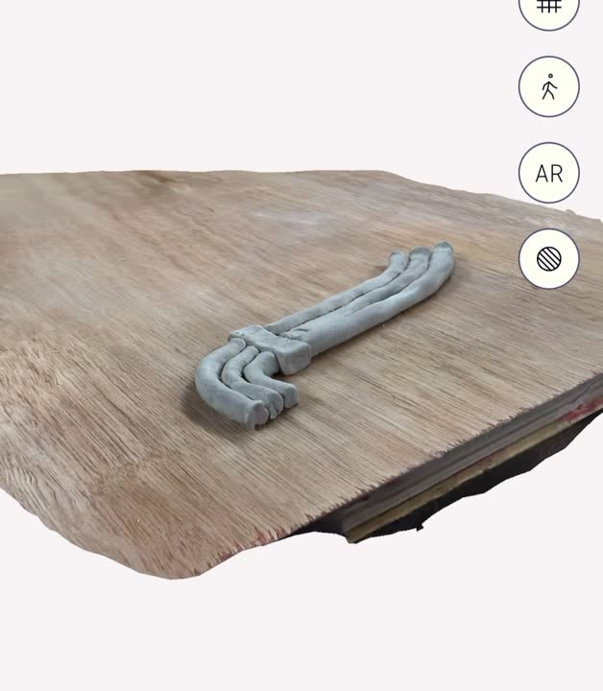
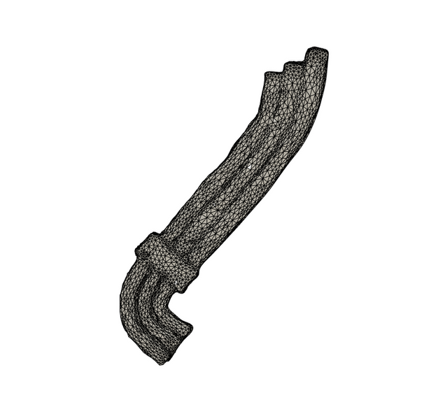
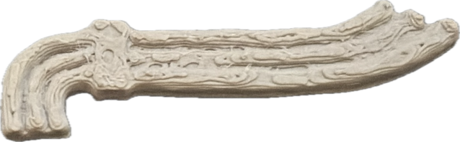
3D SCANNING
First I made an exhaust from clay and scanned it with the Polycam app, using all 150 shots for the greatest detail.
The GLTB file was then converted into an STL file and imported into fusion where all the background was cut away leaving just the exhaust.
The GLTB file was then converted into an STL file and imported into fusion where all the background was cut away leaving just the exhaust.

Slide 13
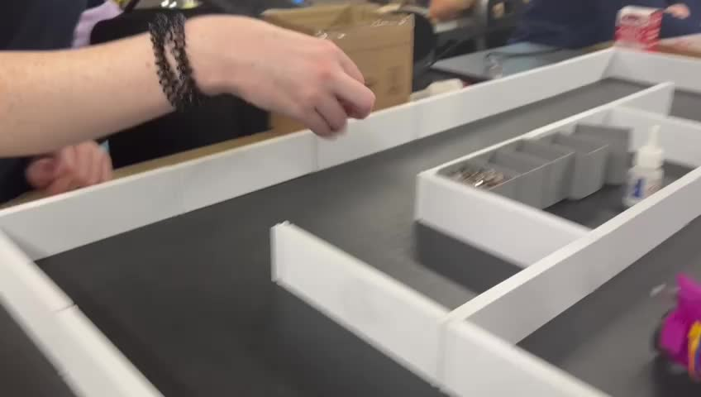
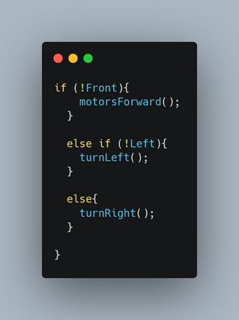
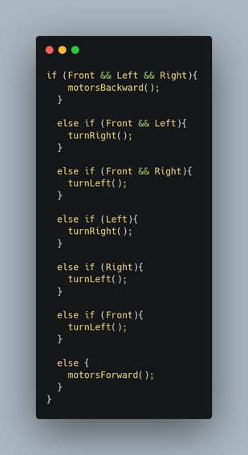
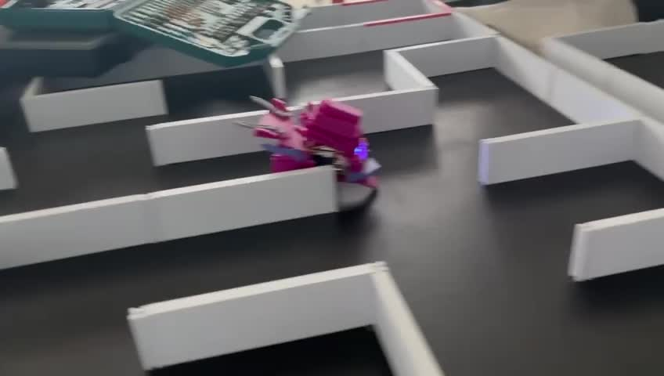
PROGRAMMING
Shorter more succinct code
while having trouble traversing
the maze it still navigated sections.
Longer more complicated code
while looking like it should have dealt
with problems actual created more.

Slide 14
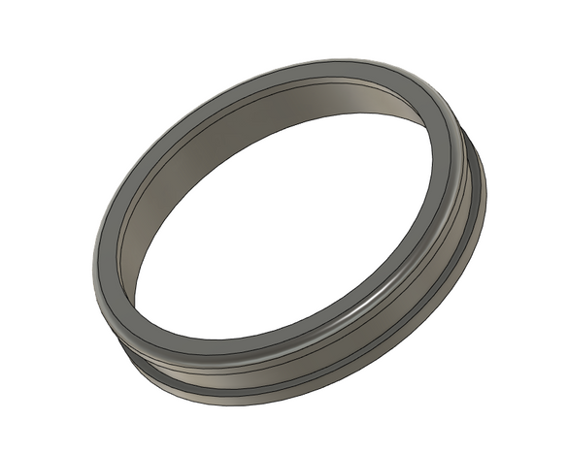
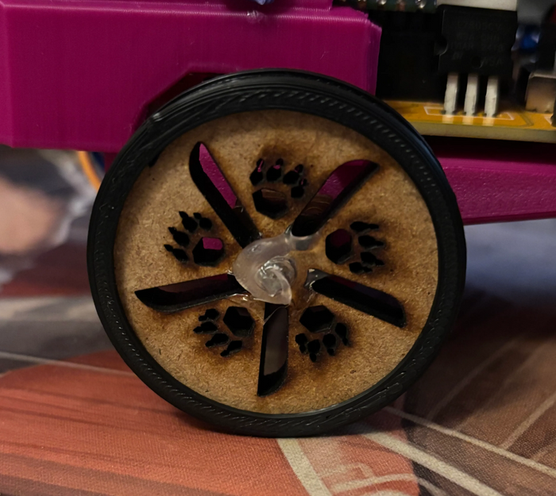
COMPOSITE
COMPONENT
An ongoing challenge was dealing with the wheels gripping the maze’s surface. Wood was easier to laser cut but didnt allow for a groove to fit an elastic band in, so I decided to use both PLA and MDF.
I created a tire within Fusion 360 that would sit ontop of the wooden wheel. This tire had an indentation allowing for the elastic band.
Polylactic Acid Tire
PLA Tire + MDF Wheel

Slide 15
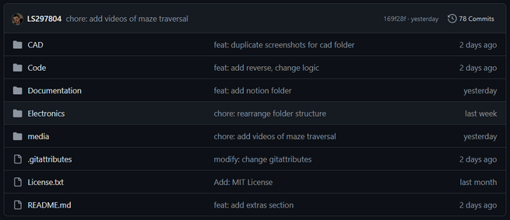
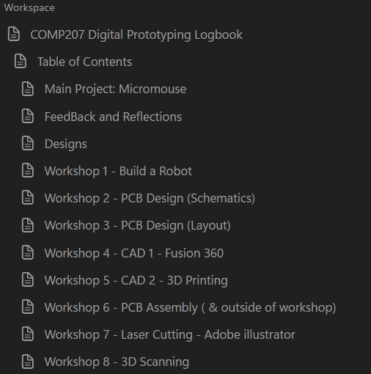
Github organised in a way to make information easily retrievable by myself and others in the future.
VERSION CONTROL AND DEVLOG
Both of these used in tandem ensured that firstly the project can be reproduced in its entirety and secondly the process of writing the devlog and readme reinforces the concepts and helps commit them to memory.
Notion arranged in a way so that I can see previous mistakes. The timeline of the project and see reasoning behind decisions made.

Slide 16
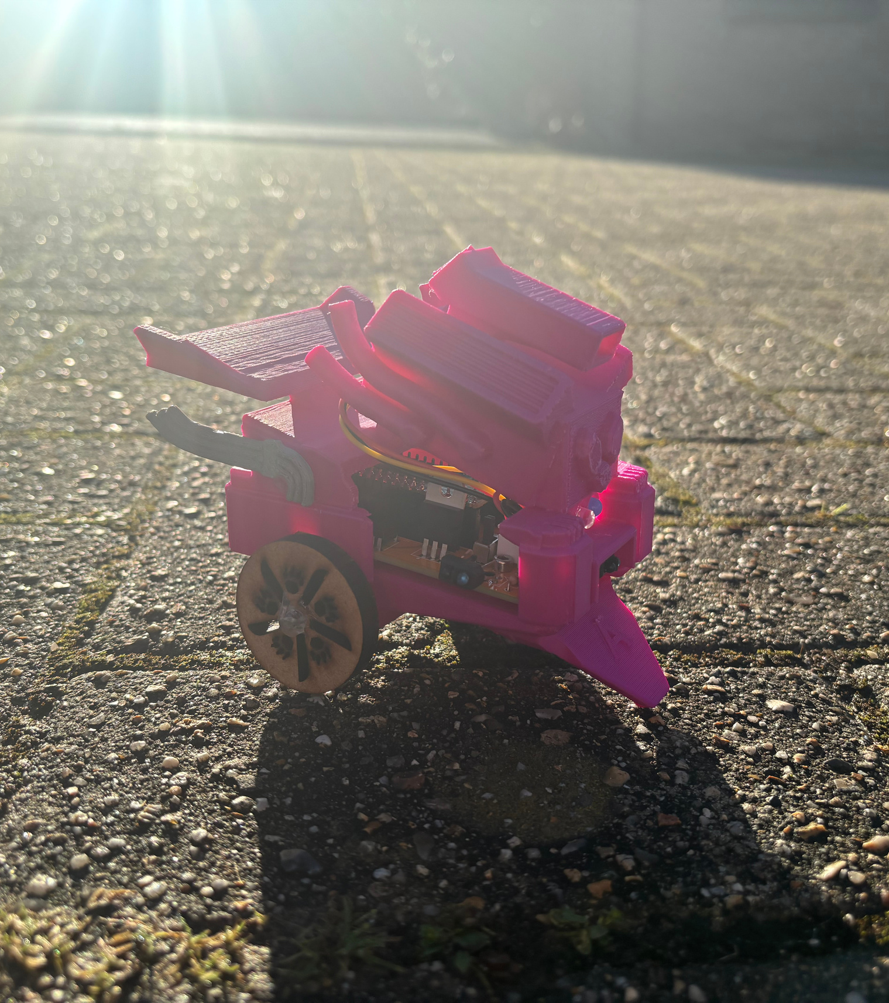
RECOMMENDATIONS
Spend more time refining code whilst looking for ways to keep complexity low.
Always refer to datasheets when creating schematics, do not rely on other sources. Minutes spent at the start will save hours later on.
Save visual flourishes in 3D designs until the item meets its functional requirements. Then go wild!
Recognising and understanding mistakes made often yields new ideas. Starting from the beginning allows the fresh implementation of them.
Algernon
The Micro-Mouse
Ask for feedback at intervals that allow time for changes to be made.

